Slide 1

PROJECT 2022-23 – REVIEW 1
DEPARTMENT OF COMPUTER ENGINEERING
GOVERNMENT POLYTECHNIC COLLEGE
TRICHY – 620 022.

Slide 2
OMR Scanner using python
MEMBERS:
Guided by
Mr. HariPrasad.M
STUDENT NAME | REGISTER NUMBER
Aswin V | 21500364
Arunachalam A | 21500363

Slide 3
OBJECTIVE
To develop image processing based optical mark recognition sheet scanning system.
To automate completely in software and avoid manual effort of correcting answer sheets.
To avoid lot of manual errors such as counting mistake during evaluation.
To evaluate multiple answer sheets and generate a single report.

Slide 4
EXISTING SYSTEM (Limitations)
Hard to scan the marking if the shades on the OMR sheet are not dark enough.
Answer sheets must be placed properly in the tray otherwise, it would un-number the scanning.
OMR scanning hardware is costly.
If the answer is incomplete, the scanner won’t be able to read it.

Slide 5
HARDWARE REQUIREMENTS
Processor :Dual Core processor 2.6.0 GHZ.
RAM :1GB.
Hard disk : 160GB.
Compact disk :650MB.
Keyboard :Standard Keyboard.
Monitor :15 inch colour monitor.

Slide 6
SOFTWARE REQUIREMENTS
Operating system : Windows OS
Programming language : python
IDLE : VS code
Modules : Open-CV ,numpy

Slide 7
BLOCK DIAGRAM
Loads input
image
Normalizes
image
Finds
contours
Finds corners among all contours
Scans each line for the marked alternative
Applies
perspective
transform to get a bird's eye view
Finds 'outmost' points of all corners

Slide 8
MODULE 1
This module loads input image from user.

Slide 9
MODULE 2
In This Process Adjusd The Ratio Of The Image.

Slide 10
MODULE 3
This stage is to finding the contours in the images.

Slide 11
MODULE 4
Scans each line for the marked alternative and generates report.

Slide 12
CONCLUSION
Thus a high efficient semi-automated OMR scanning system has been developed.
This would help examiners to evaluate answers without mistakes in quick time.

Slide 13
FUTURE ENHANCEMENT
This system could be developed as Android
mobile app.
App could use camera to take images and feed it into system for image processing

Slide 14
REFERENCES
OMR Software - A list of popular OMR software options, including free and paid options, as well as user reviews and ratings.
OMR Blog - A blog dedicated to discussing various aspects of OMR technology, including best practices, tips and tricks, and industry news.

Slide 15
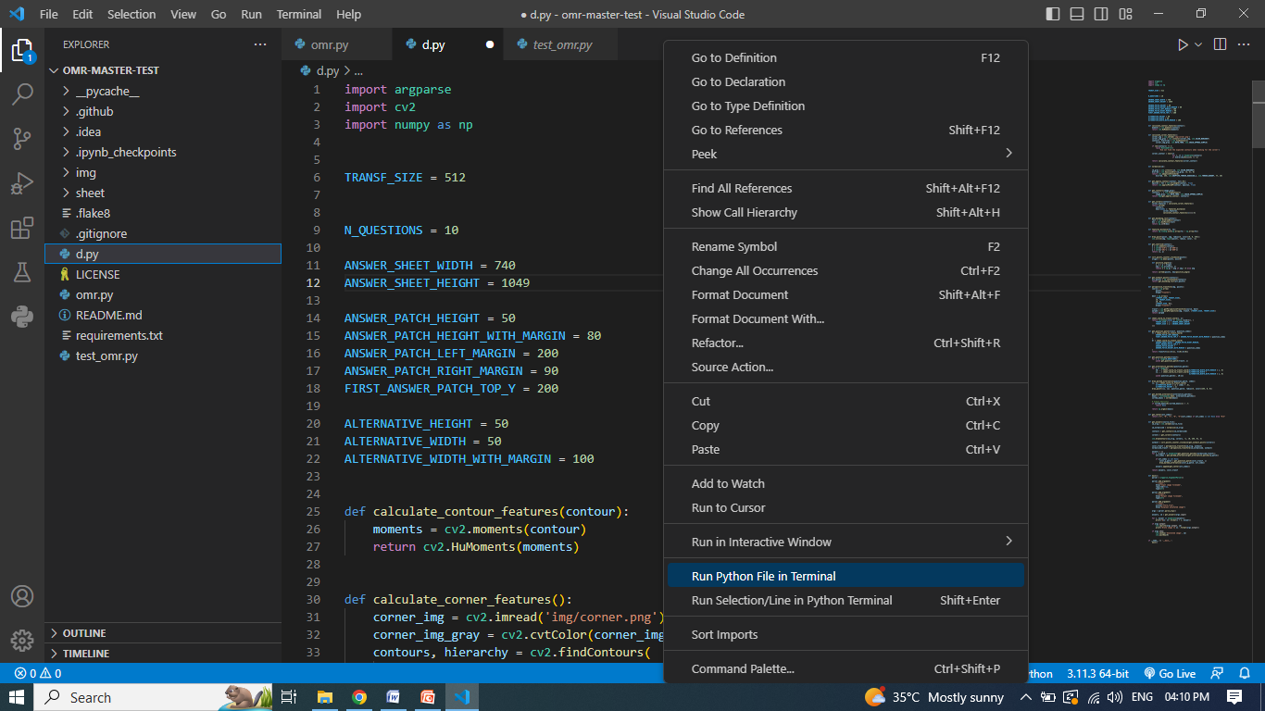
SCREENSHORT

Slide 16
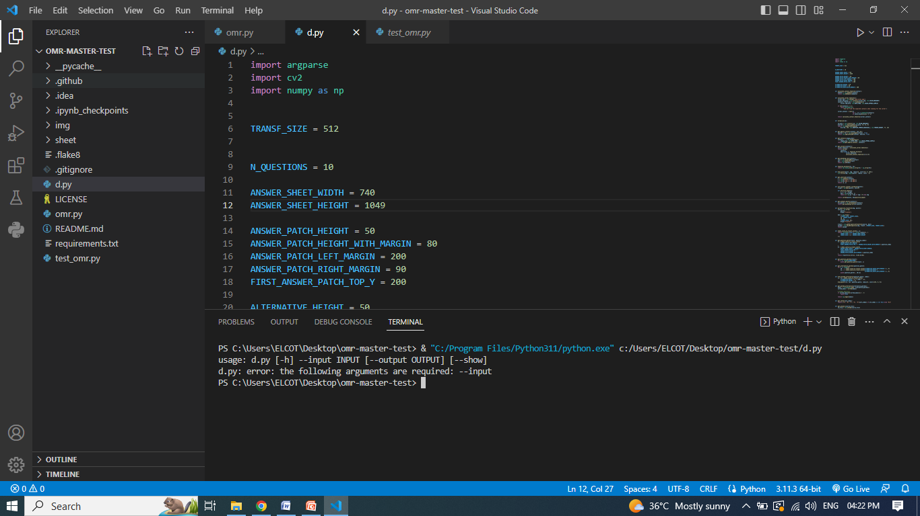

Slide 17
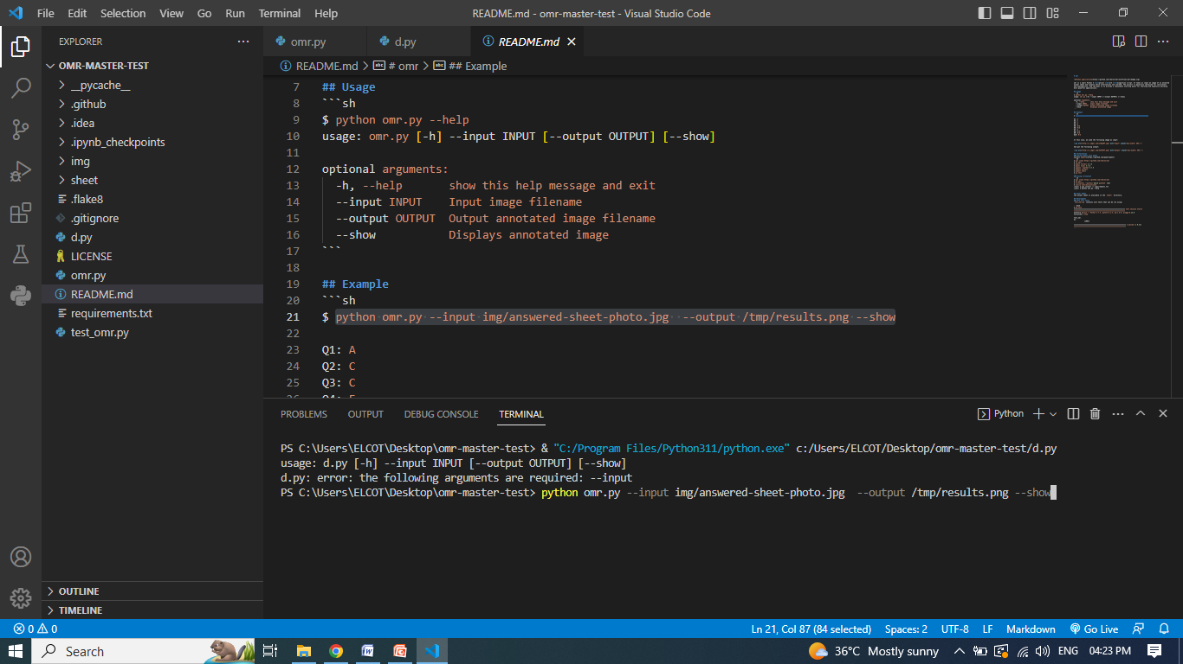

Slide 18
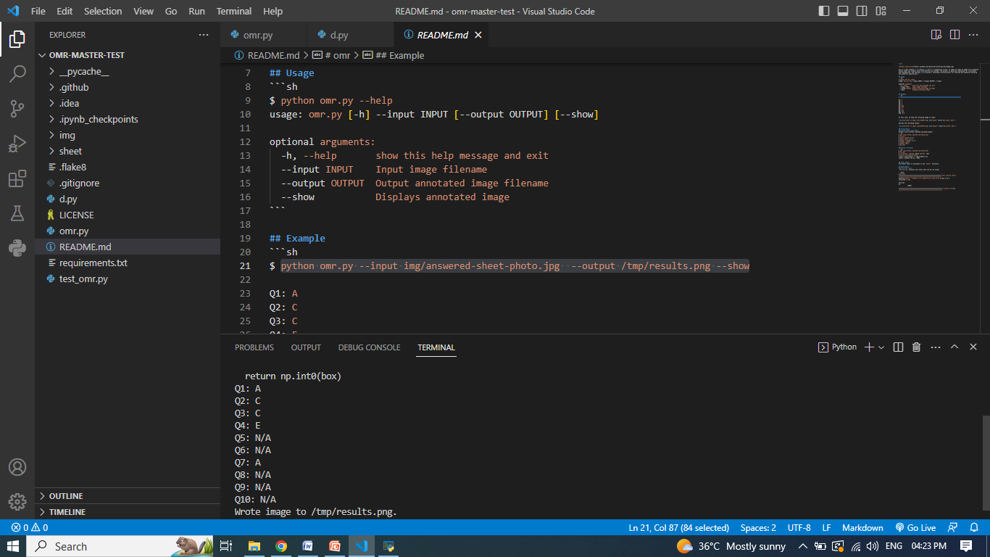

Slide 19
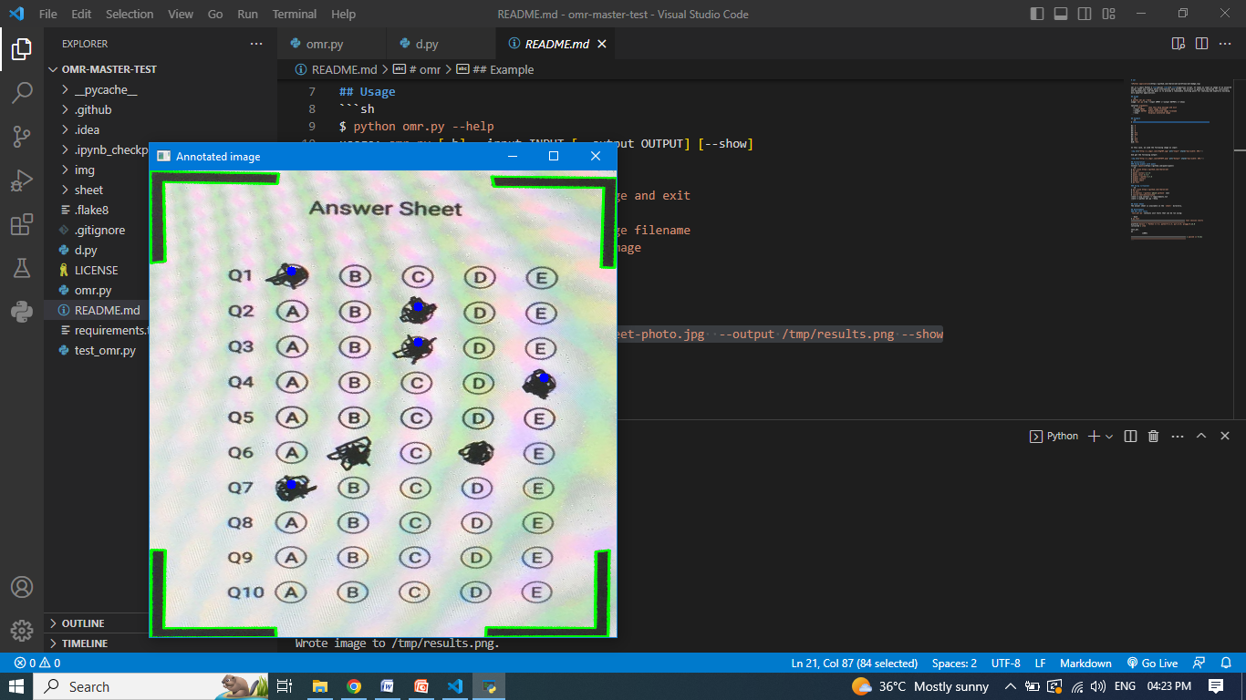

Slide 20
THANK YOU

Slide 21
QUERIES?

